Slide 1
Revamping the Attendance Taking System
Daniel Quah (P1419719)
Justin Xin (P1531516)
Notes:
CONFIDENTIAL: INTERNAL DISTRIBUTION ONLY

Slide 2
Current Implementation of ATS
Pros
Efficient
Students submit their own attendance
Only usable within SP compounds
Unique code for each lesson
Cons
Easily bypassed
Code is easily transmitted over other mediums
No checks for student presence
Notes:
Efficient -> Great for tracking students attendance
Students submit their own attendance -> Increase productivity on lecturers since they do not need to waste time to mark attendance
Only usable within SP compounds -> Students cannot submit the code if they are not connected to SPStudent
Unique code for each lesson -> Impossible for student to guess the code for next lesson, which ensures that they are in class
Code is easily transmitted over other mediums -> Students can send the code to their friends via WhatsApp / SMS / calls / other mediums
No checks for student presence -> ATS assumes students are in class, it place the burden on lecturer to check, which results in lost of productivity.

Slide 3
Petition to remove ATS
In 2015, a group of students started a petition on change.org and gathered about 740 out of the required 1000 signatures.

Slide 4
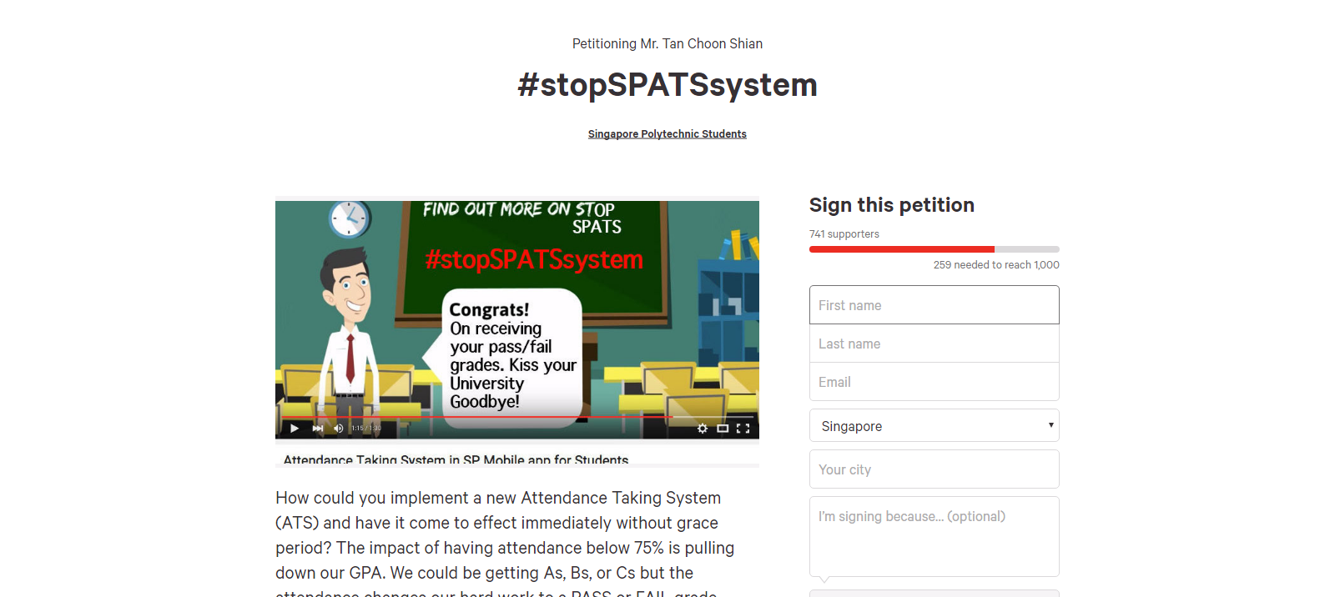

Slide 5
Problems
6 digit code easily reproduced and redistributed
Students tend to forget to enter the code
Notes:
Numbers can be easily typed and sent to anyone else in school
You don’t have to be in class to submit

Slide 6
Problem: 6 digit code easily reproduced and redistributed

Slide 7
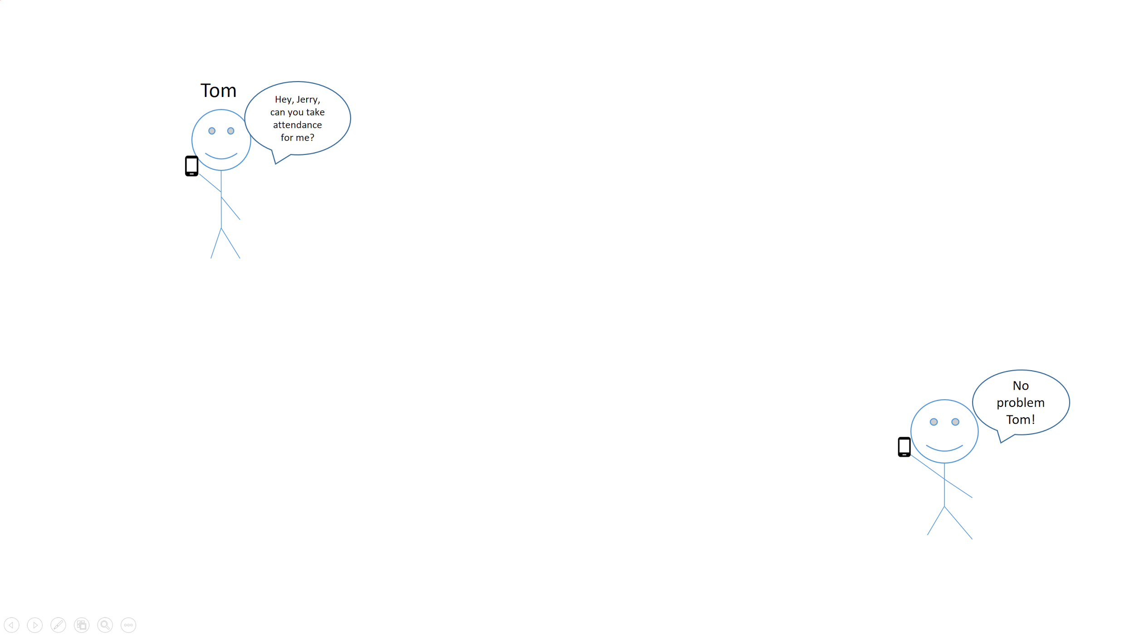
Problem
Scenario:
Tom is at FC3, and decides to skip class.
He asks his friend Jerry to send him the attendance code.
If the lecturer does not check, Tom’s attendance is marked present, despite him not being in class.
Jerry

Slide 8
Solution 1: Change the distribution method
Provide the code in a medium that the students cannot easily reproduce.
Notes:
Medium chosen: combination of wifi, bluetooth and near-ultrasound waves

Slide 9
How?
Lecturer broadcast code
Students receives the code on their mobile phones
Student’s device automatically submit the code to ATS server

Slide 10
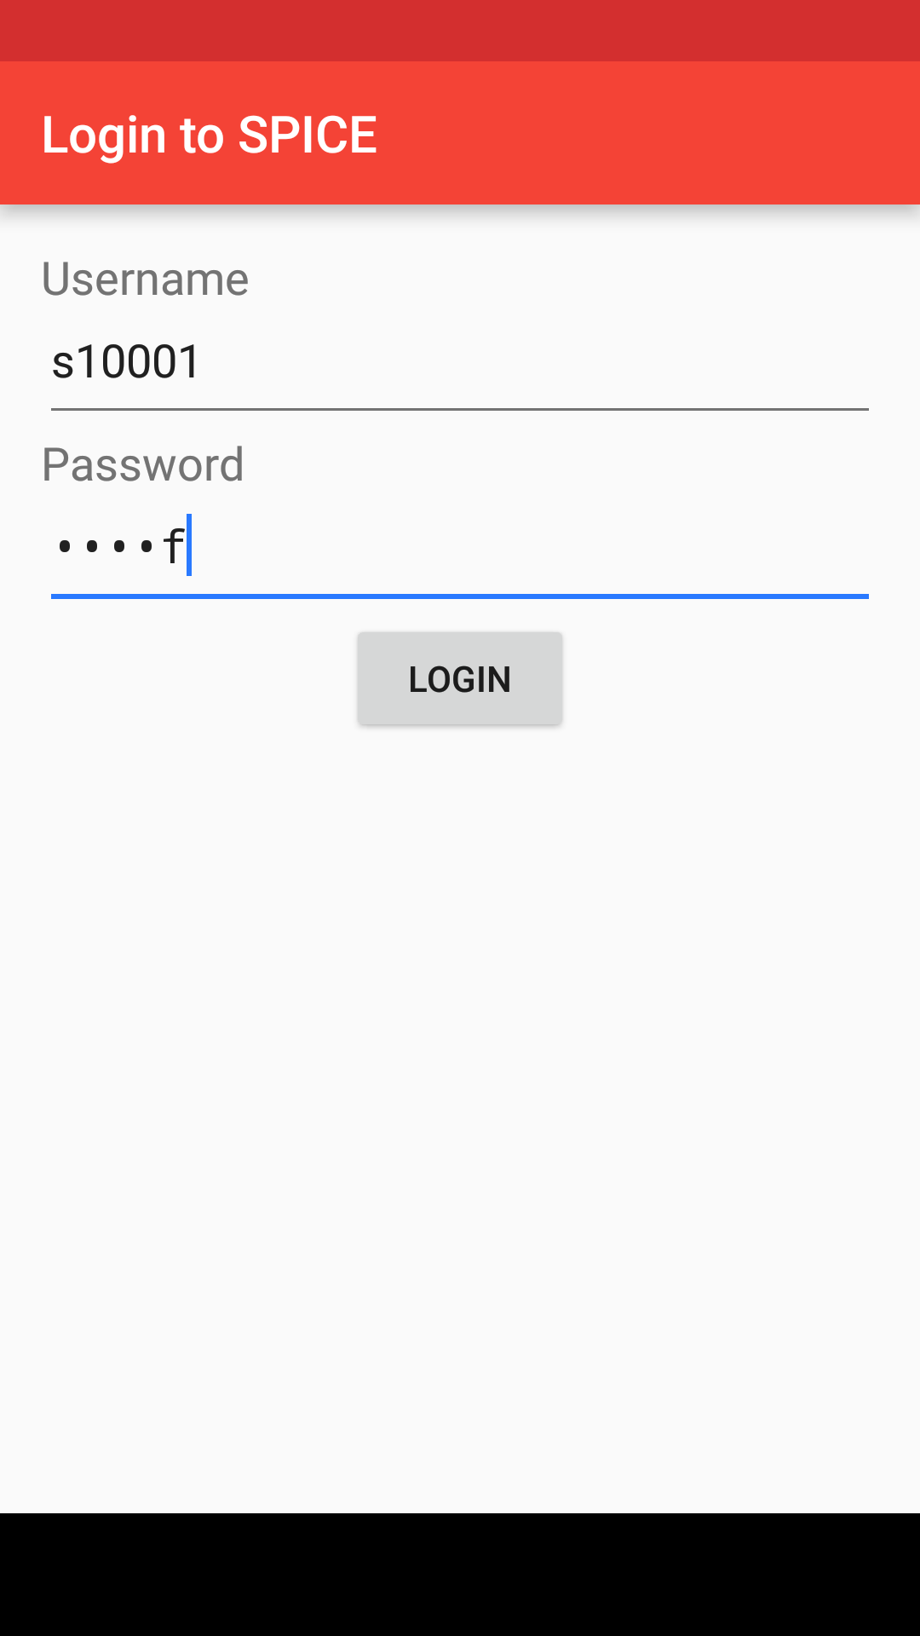
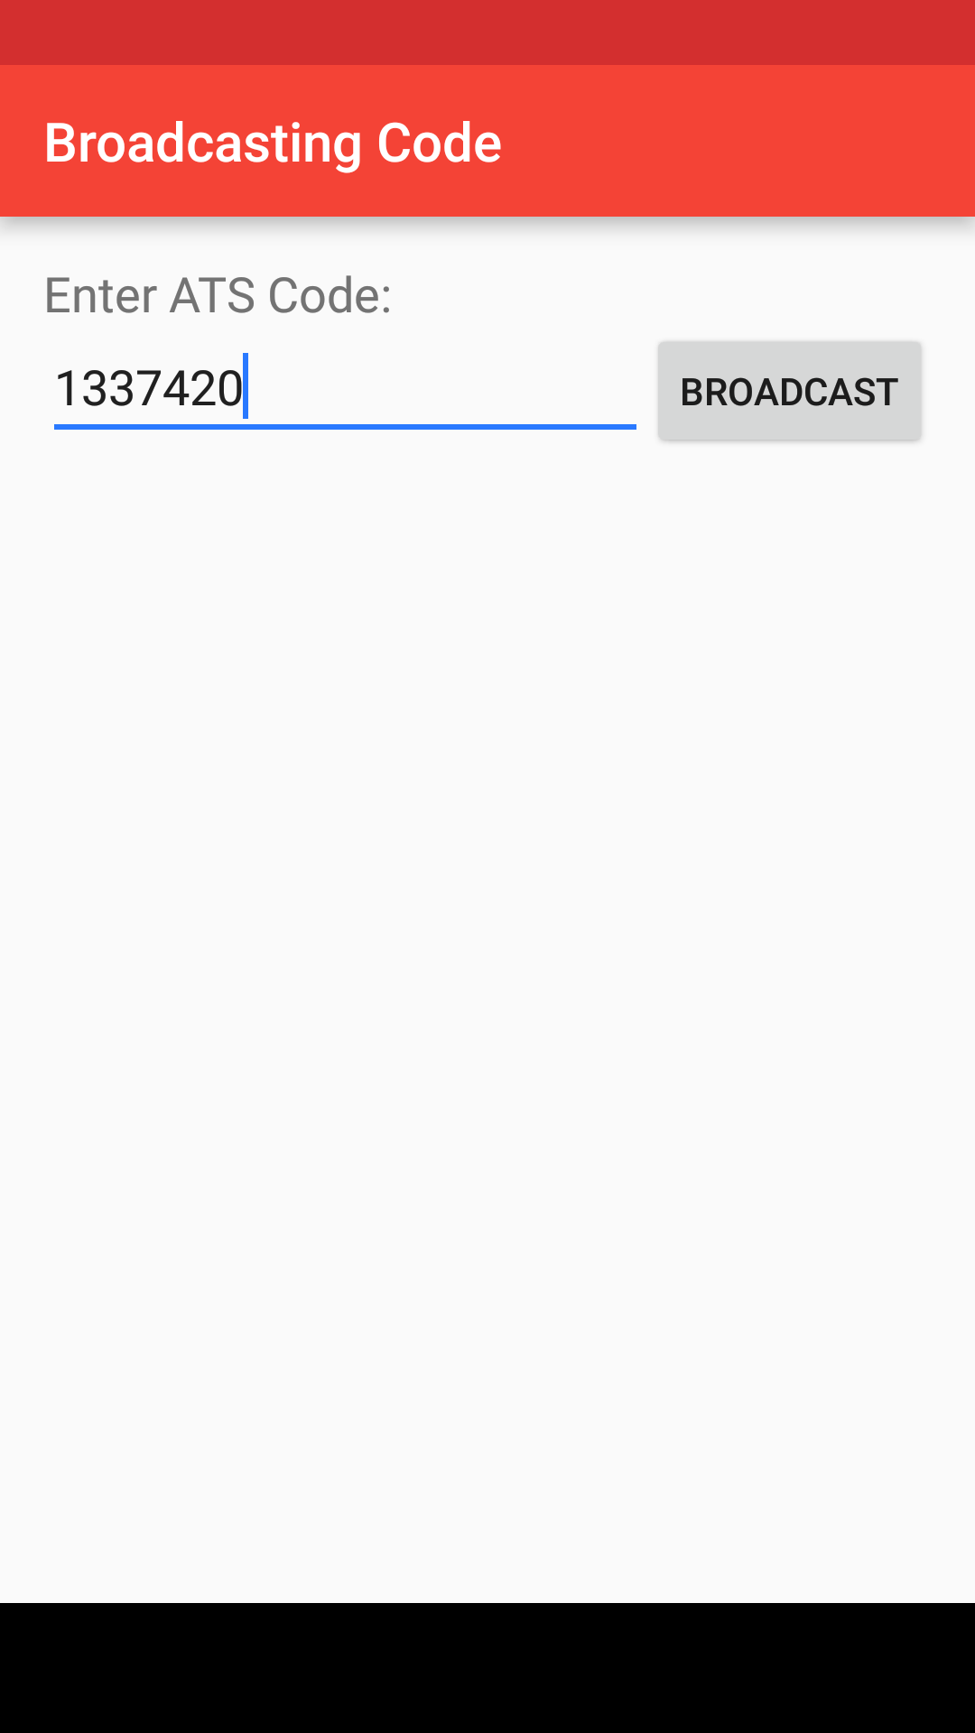
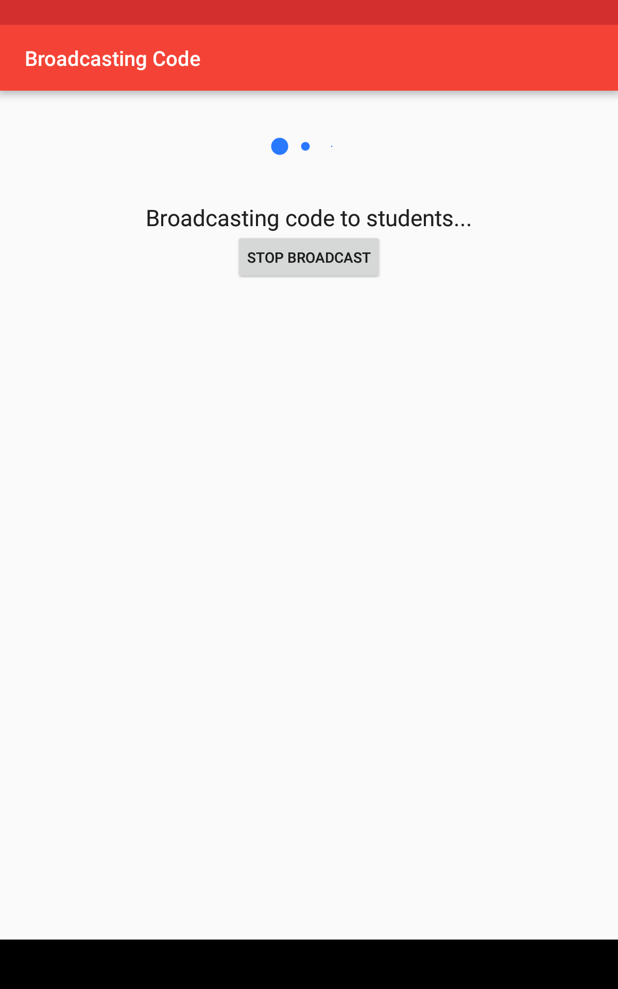
Lecturer workflow
Notes:
Lecturer key in their SPICE credentials.
Lecturer inputs ATS code
Lecturer broadcasts code to students
Now, only lecturer knows the ATS code and not the student, which prevents the student from passing the code to their friends.

Slide 11
Near-Ultrasound Facts
Should not be confused with ultrasound
Frequencies used: 17 - 21 kHz
Compatible with current day speakers and microphones
Works in unsavory environment
No health risks involved
Notes:
Near-ultrasound should not be confused with ultrasound
Compatible with current day speakers and microphones, resulting in cost savings
Works in unsavory environment, noisy environments included. Tested at FC3 and MRT
No health risks involved(no radiation)
Does not damage hearing

Slide 12

Scenario
Hilltop Library
Tom
Class 2026
Lecturer
Tom’s friend
Notes:
TODO: Animations (PPT)
Tom is at the Hilltop Library, and decides to skip class. He decides to attempt to receive the near-ultrasound waves by standing outside the classroom.
As near-ultrasound can only travel up to 30 meters and will not be able to penetrate through walls, Tom is unable to receive the attendance code.

Slide 13
Why Near-Ultrasound?
Distance manipulation with sound
Sound does not pass through walls
Notes:
Based on options given to the oscillator producing the near-ultrasound waves, distances the waves can travel can be manipulated. This means it’ll be possible to create a small distance presence checking system.

Slide 14
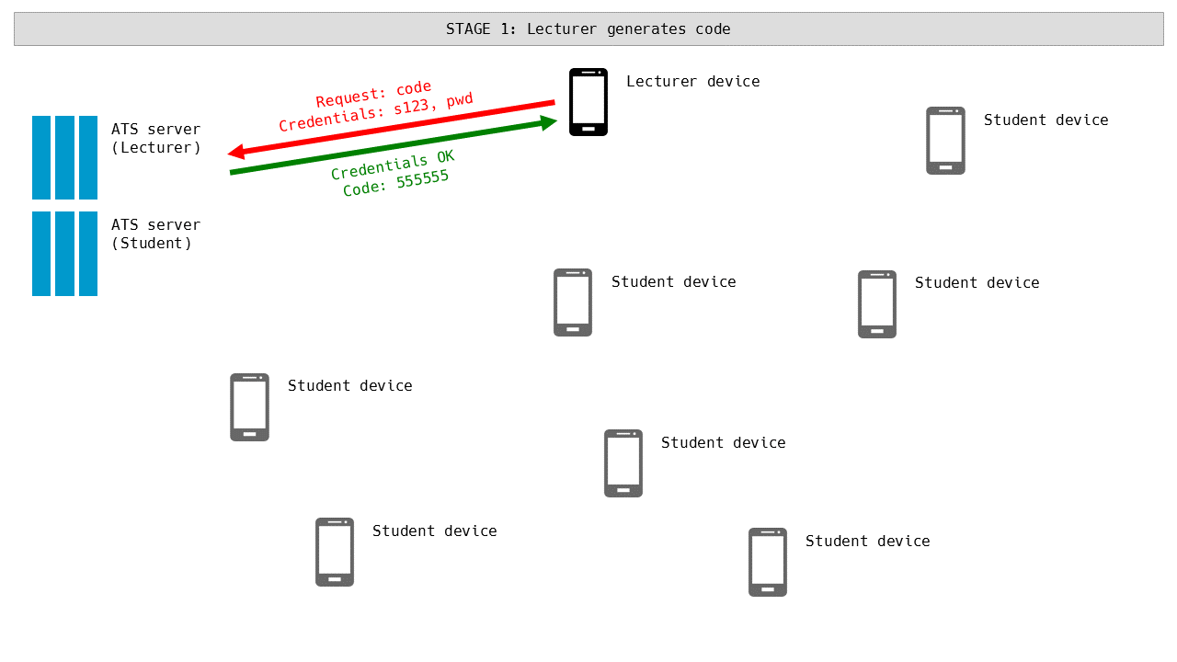
Graphical Representation
Notes:
TODO: New graphics
Lecturer will generate the code as per normal, and inputs the code into the new app

Slide 15
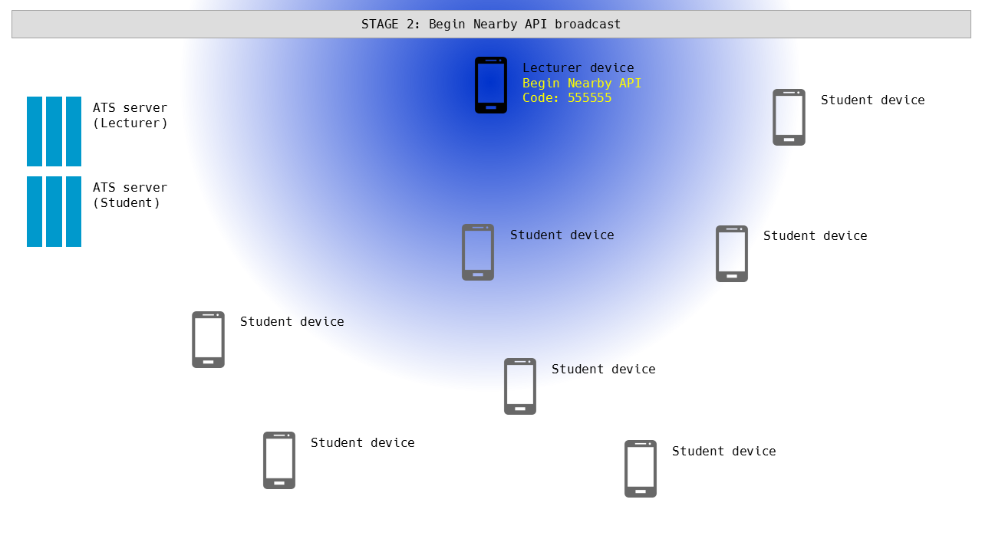
Notes:
TODO: New graphics
Lecturer’s device begins emitting near-ultrasound waves
Student devices pick up near-ultrasound waves

Slide 16
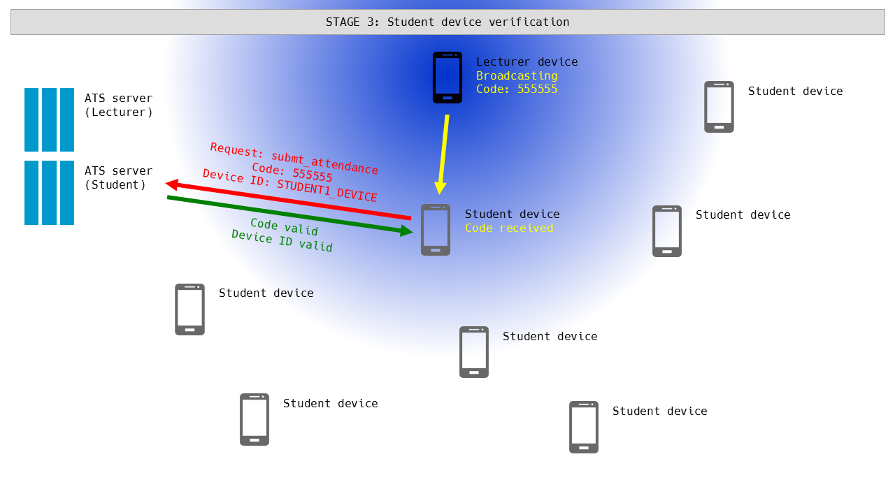
Notes:
TODO: New graphics
App will send code and device ID to a proxy server
Proxy server will check that the device has not been used to sign into ATS in the last 30 minutes
If the device has not been used to sign into ATS in the last 30 minutes, the code is submitted normally
If the device has been used to sign into ATS in the last 30 minutes, the code is not submitted

Slide 17
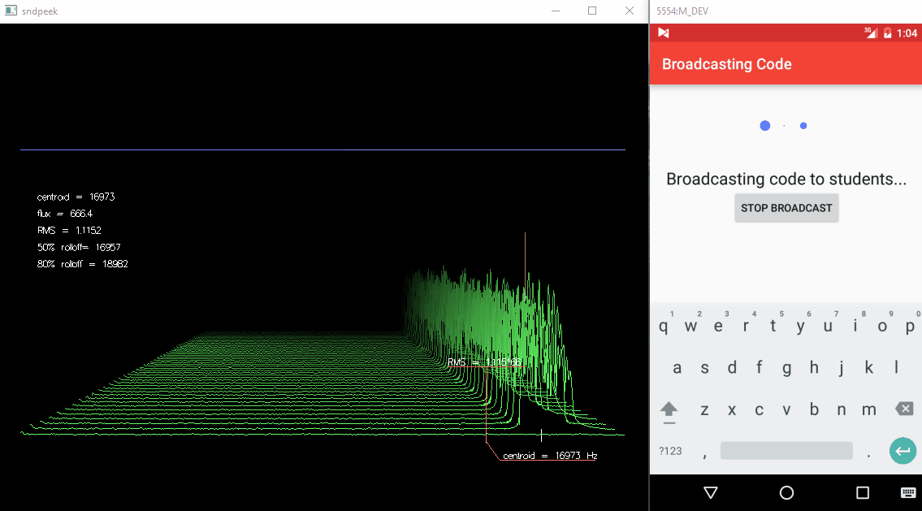
Stereo Mix (Nearby Audio Output)

Slide 18
Solution 2: Ensure that one device only submits for one student
Before submitting the code, the app checks if the device has already submitted the attendance for a student once.
Notes:
Unique device ID will be sent to proxy server for checking, before code is processed and submitted normally
Depending on result of code submission, device ID may or may not be stored for 30 minutes to verify that the same device does not log in twice

Slide 19
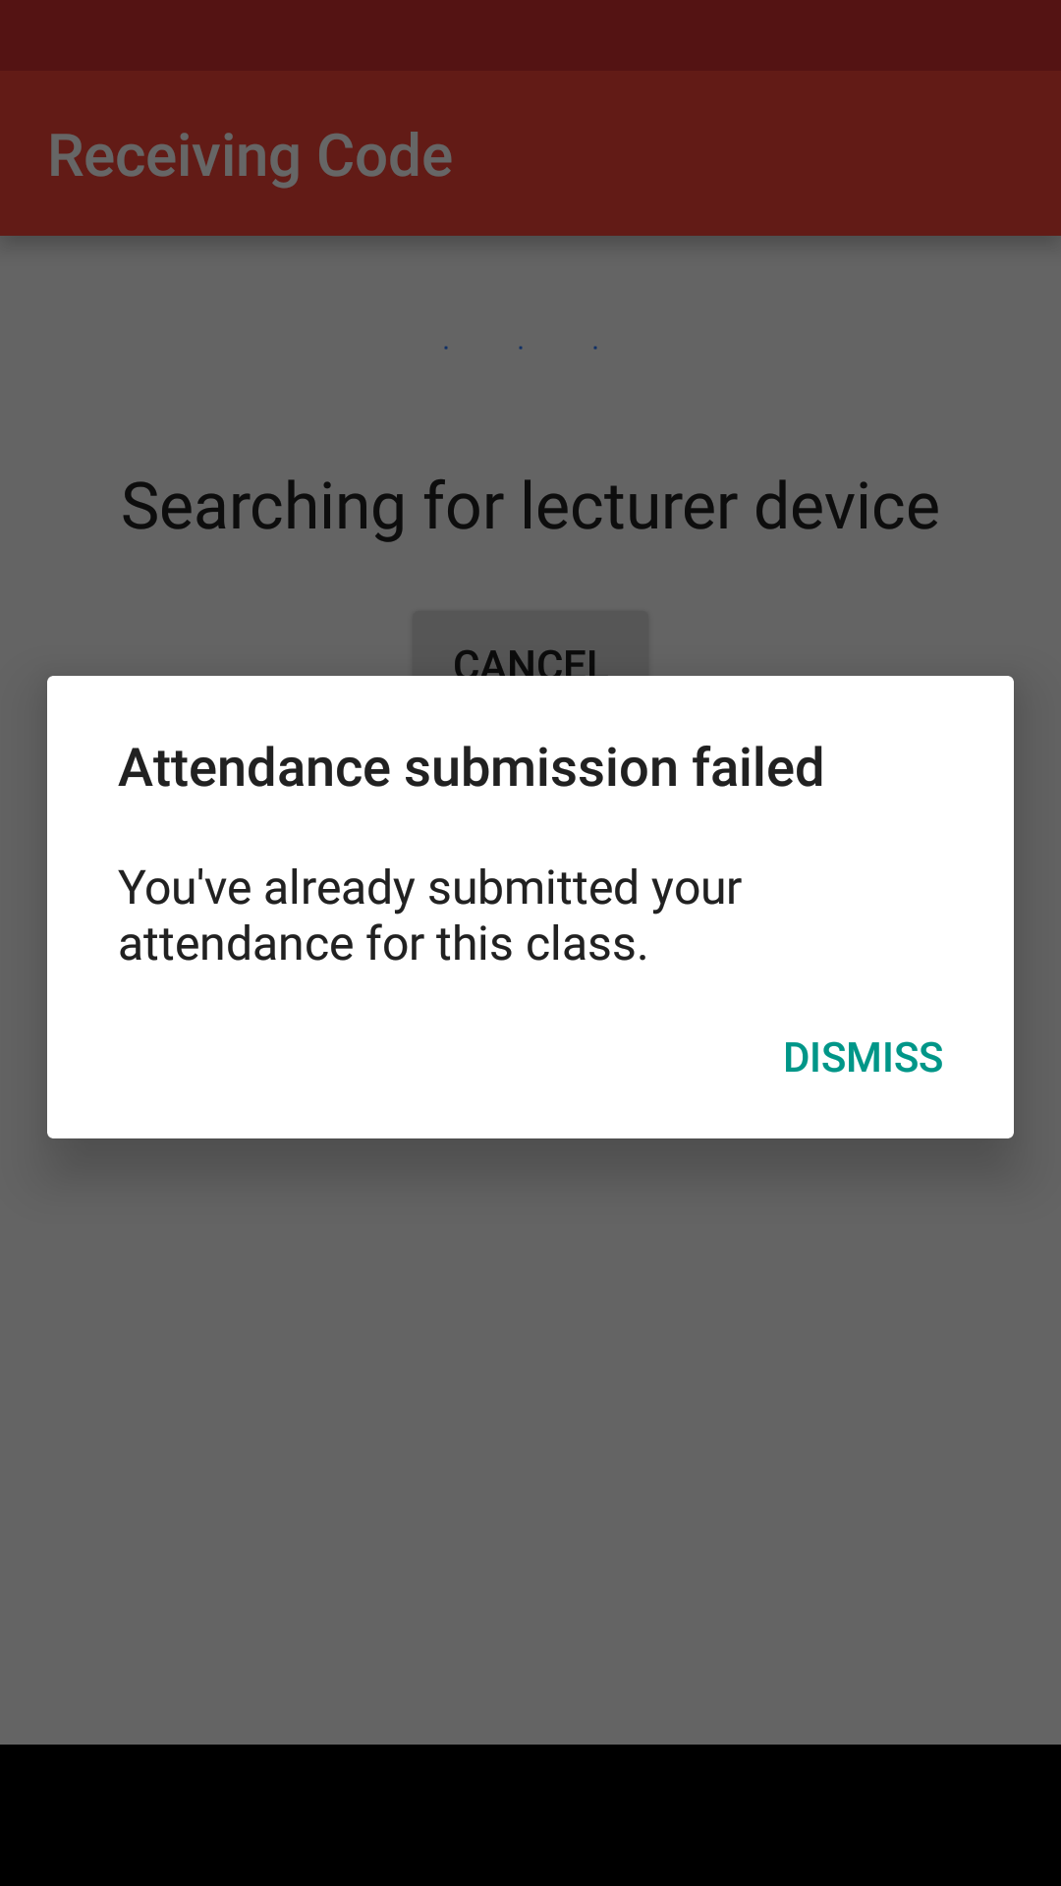
Scenario
Classroom
Mary
Harry (outside SP)
Notes:
TODO: Animations (PPT)
Harry will be late for school, so he asks Mary to submit the code for him. Mary only has 1 device, and submits her attendance first. Mary then logs out of her account, and signs into Harry’s account. The attendance submission fails, as her device has already signed in in the last 30 minutes.

Slide 20
Step 1: Verify presence
Presence: valid

Slide 21
Step 2: Connect to verification server
Presence: valid
Verification server connected

Slide 22
Step 3: Verify device ID
Presence: valid
Verification server connected
Device ID is present in temporary database
Device ID is not present in temporary database

Slide 23
Step 4: Server acts accordingly
Presence: valid
Verification server connected
Device ID is present in temporary database
Device ID is not present in temporary database
Do not send code to ATS
Send code to ATS
Get ATS result
Return result to device:
DEVICE_ALREADY_SUBMITTED
ATS submitted:
Store device ID until code expires
ATS not submitted:
Do not store device ID
Return result:
DEVICE_SUCCESSFUL
Return result:
DEVICE_ATS_UNSUCCESSFUL

Slide 24
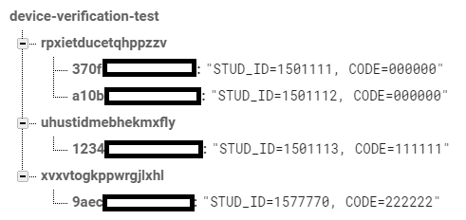
Sample Database
Unique class ID (generated by lecturer’s device)
Student ID and attendance code
Device hardware ID

Slide 25
Problem: Students tend to forget to enter the code

Slide 26
Problem
Scenario:
Tom enters class early, and prepares for lesson.
However, as the lecturer tells the class what the code is, he forgets to submit it.
Tom is therefore marked absent, despite his presence in class.

Slide 27
Solution: Notify students to submit their attendance
Low-energy beacons installed in every classroom will send notifications to the students’ devices, reminding them to submit their attendance.

Slide 28

What is a beacon?
Notes:
When we talk about beacons, the above image comes into mind, however...

Slide 29
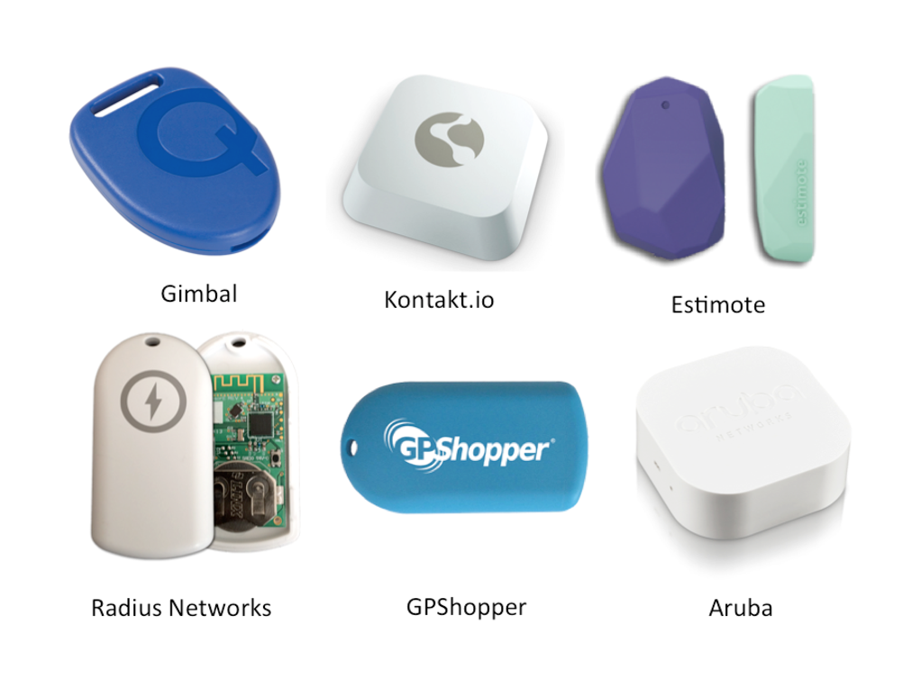
‘Physical Web’ Beacons

Slide 30
Hardware used

Slide 31
How does it work?
Bill is very forgetful and always forgets to submit his attendance.
With the beacons in place, the beacon will send a notification to his phone when he enters the classroom, reminding him to submit his attendance.

Slide 32
Efficient distribution of class materials
The lecturer wishes to share some class resources. He sends the URL of the files to the beacon. Whenever a student enter the room, the student will be prompted to download the files for the lesson.
Notes:
Other use cases 1

Slide 33
On-demand campus directions
Instead of having maps all over SP, the beacon can act as waypoints.
Notes:
Other use cases 2

Slide 34
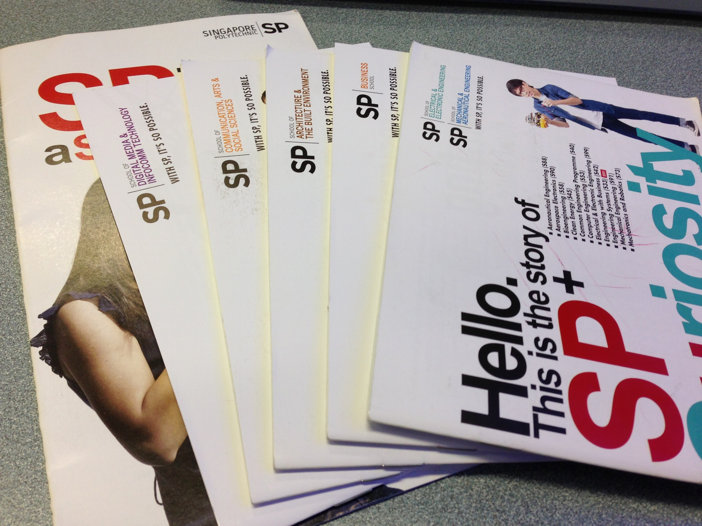
Open House
Beacons can provide more information to visitors directly through their smartphones, eliminating the need for paper brochures.
Notes:
Other use cases 3

Slide 35
Other uses
Bookstore promotions
Starbucks promotions
Booking of facilities
Notes:
Whenever the bookstore at FC5 runs promotional events, students are notified when they walk past it.
Beacons can be used to book rooms at moberly. Students just need to install an app and based on information from beacons placed inside meeting rooms, they can check if a room is already occupied or when a meeting will be over. It can even inform room occupants when their bookings are about to end.

Slide 36
Beacon vs NFC vs QR code
NFC & QR code are much more passive compared to beacons. With beacons, information is pushed to you instead of you finding information.

Slide 37
Current uses
The United Nations Mine Action Service (UNMAS) has been using beacons to educate the public about the dangers of landmines. Their mobile app ‘Sweeper’ helped make the experience possible, alongside the beacons.
Notes:
http://getsweeper.com/

Slide 38
Current usage in SG
In 2014, 313@Somerset has implemented beacons in participating outlets and shoppers will get deals whenever they walk by.
EpiCenter deployed iBeacons throughout all of their chain.
Notes:
App: https://itunes.apple.com/sg/app/tring-313/id562893741?mt=8

Slide 39
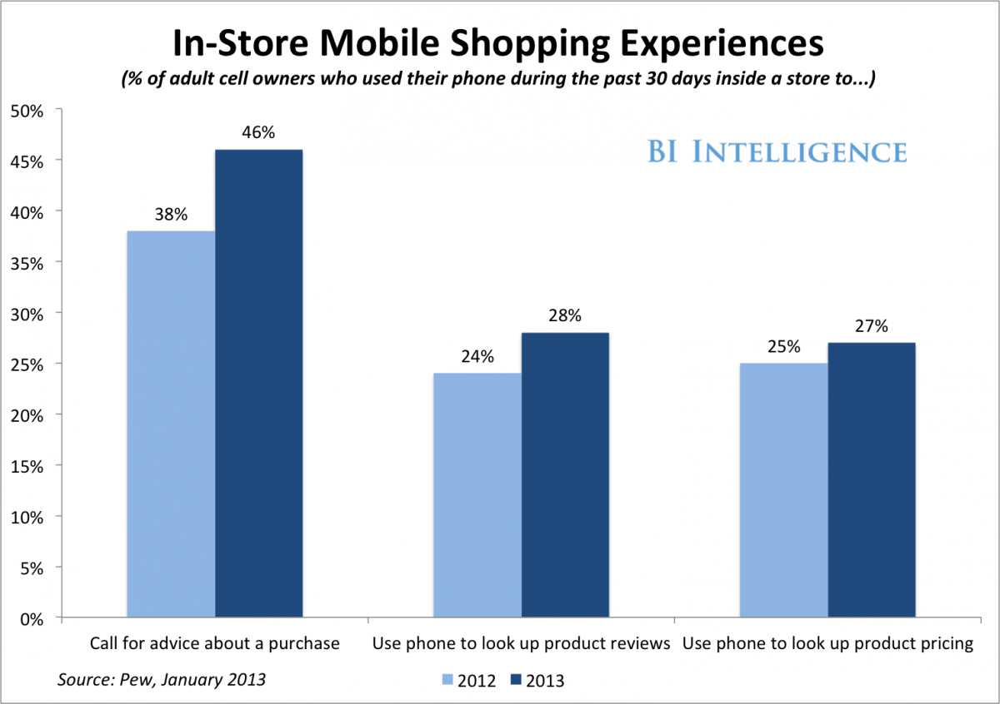
Beacons will change the way we shop
People are increasingly
using mobile devices before
purchasing a product.
Notes:
Instead of finding information on the internet or asking for help, beacons helps to tell you more information on the product before you buy. This will free up the shop’s assistance time as information is presented to the shopper.

Slide 40
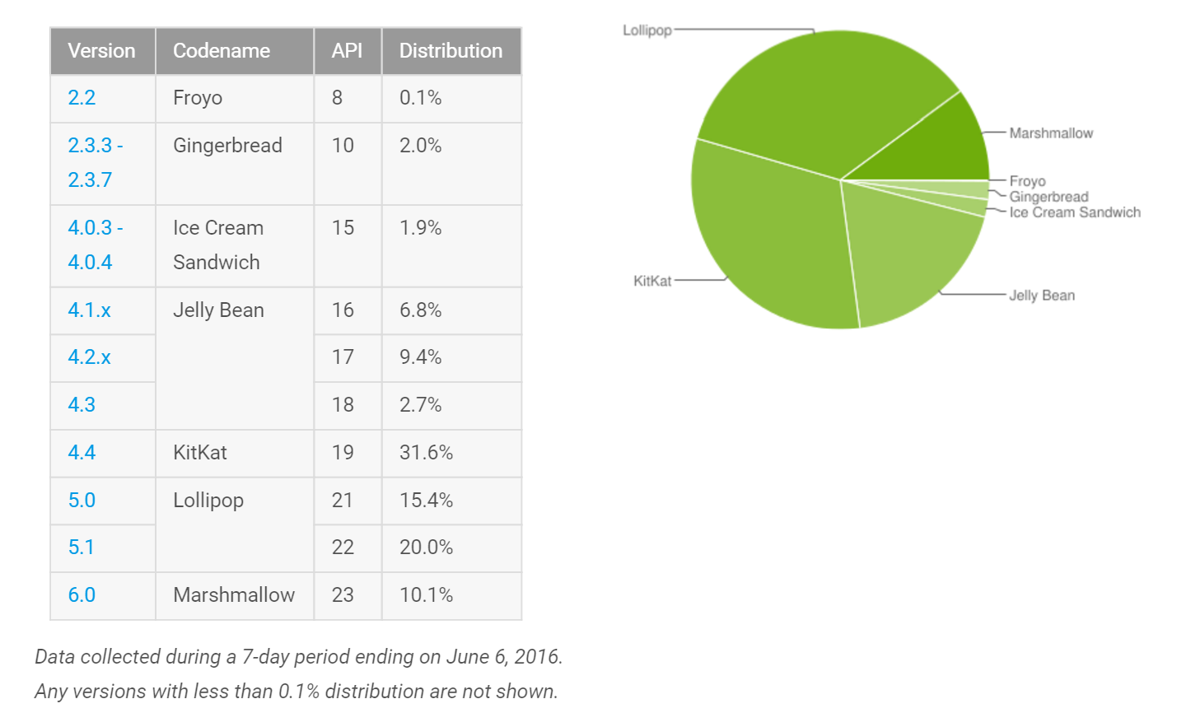
Supported Devices
Notes:
Reason for using these APIs
Support from API 18 which accounts for 79.8% of android devices. Devices bought after 2012 will be supported.
iOS supported as well!
However, with

Slide 41
Sources
Android Developer dashboard [Online]. Available from: https://developer.android.com/about/dashboards/index.html [Accessed 26 June 2016]
Nearby Messages (100 days of Google Dev) [Video]. Available from: https://www.youtube.com/watch?v=hultDpBS22s [Accessed 3 June 2016]
UN Exhibit Uses BLE to Demonstrate The Danger of Landmines[Online]. Available from: http://www.ipglab.com/2014/04/04/un-landmines/ [Accessed 25 June 2016]
Report[Online].Available from: https://thisizwayneeeee.wordpress.com/2013/01/11/report/ [Accessed 26 June 2016]
Soon: Alerts to shoppers based on tracking of their shopping pattern at mall [Online]. Available from: http://www.straitstimes.com/singapore/soon-alerts-to-shoppers-based-on-tracking-of-their-shopping-pattern-at-mall [Accessed 27 June 2016]

Slide 42
Yext Launches Xone Beacon Network For Offline-To-Online Engagement[Online]. Available from: http://marketingland.com/yext-launches-xone-beacon-network-for-offline-to-online-retargeting-144502 [Accessed 28 June 2016]
BEACONS: What They Are, How They Work, And Why They’re Important[Online]. Available from: http://www.businessinsider.sg/beacons-and-ibeacons-create-a-new-market-2013-12/ [Accessed 28 June 2016]
How EpiCentre used iBeacon to integrate online and offline [Online]. Available from: http://www.marketing-interactive.com/events/epicentre-made-location-based-technology-key-part-loyalty-programme/ [Accessed 28 June 2016]
The Future of….Beacons[Online]. Available from: https://tinyletter.com/ElectronicInterestingness/letters/the-future-of-beacons [Accessed 28 June 2016]
https://www.change.org/p/mr-tan-choon-shian-ms-georgina-phua-stopspatssystem

